Slide 1
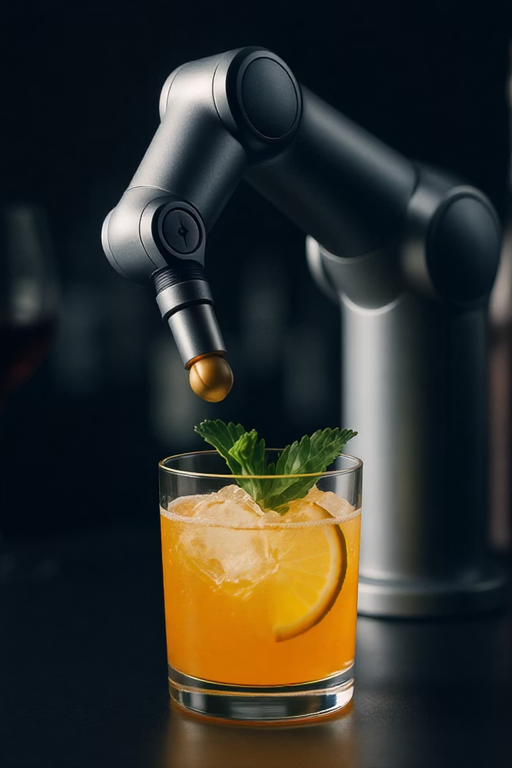
Introduction to the BarBot
Welcome to the future of mixology! Bar bot is an automated mocktail mixing robot project. It delivers precise, custom drinks on demand. We drew inspiration from open-source and maker communities.
Shimmer , Saveer and Jwalla

Slide 2
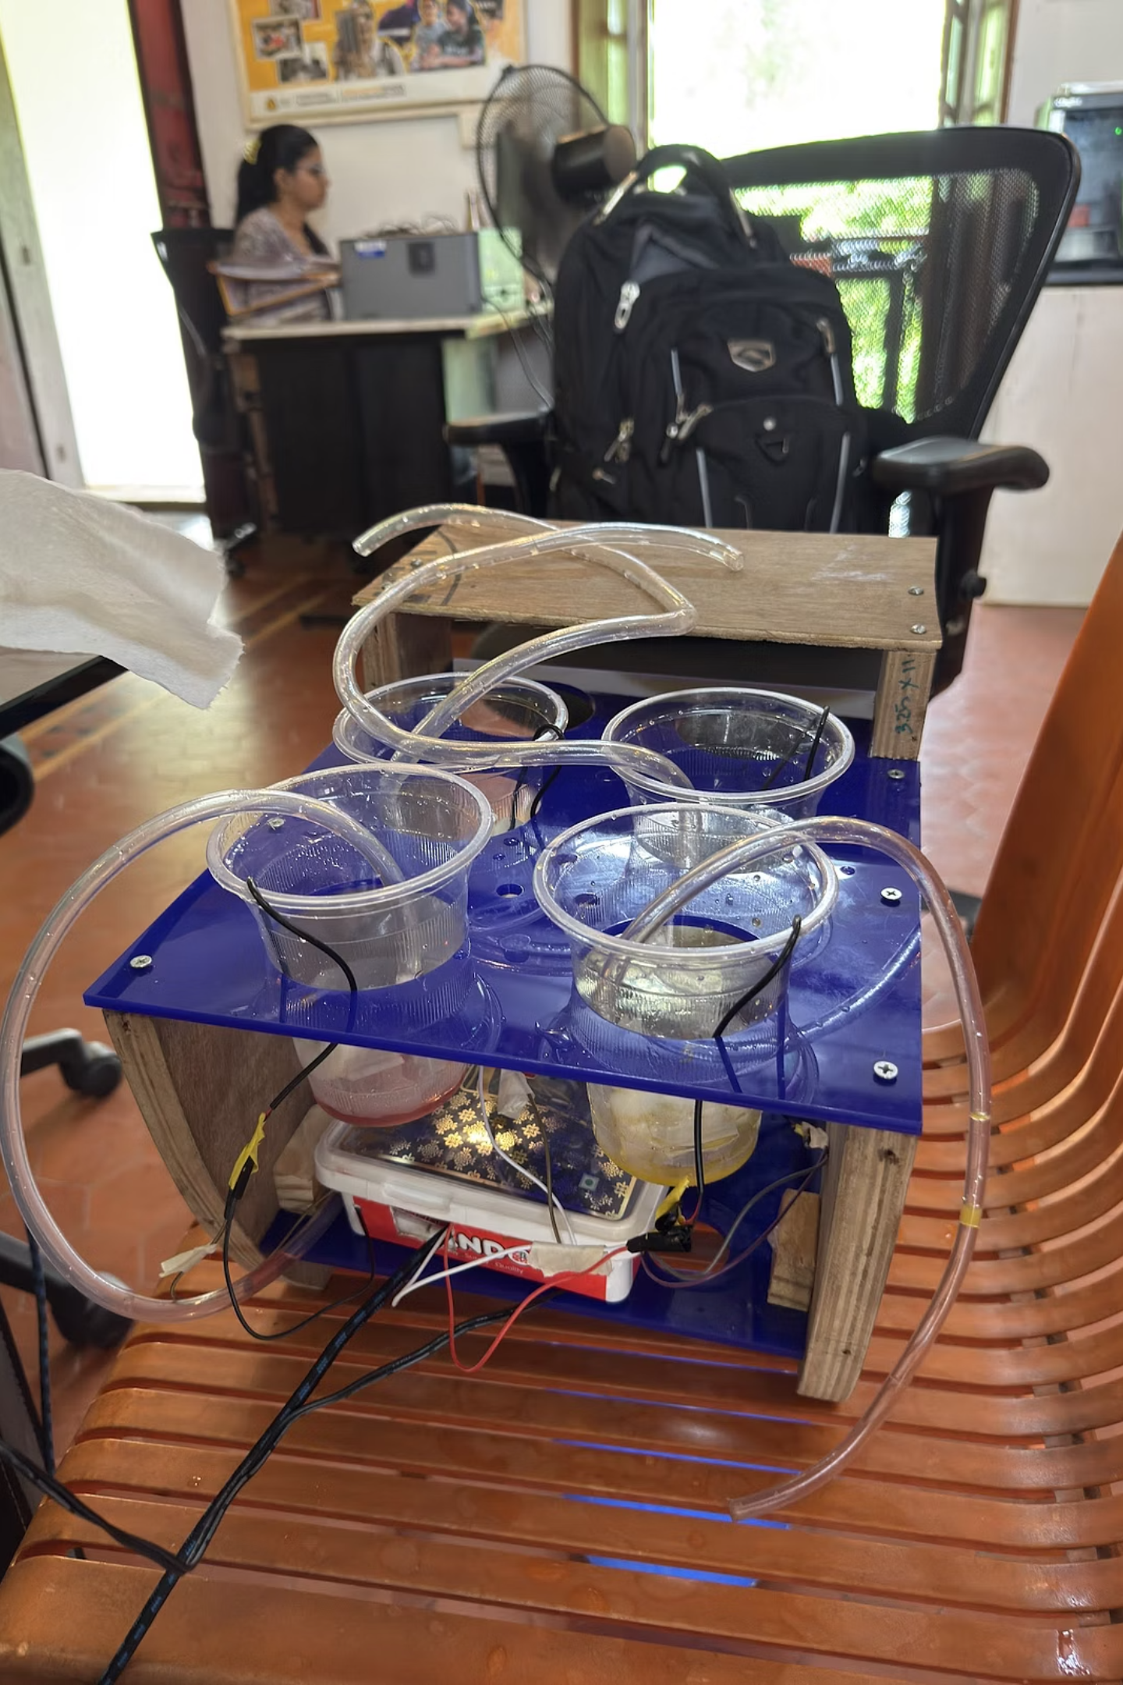
What is the BarBot?
Mocktail Preparation
Precision Dispensing
Robot designed to prepare cocktails.
Dispenses correct amount of each.
Uses up to 6 unique ingredients.
Ensures precise, consistent drinks.
Ideal Applications
Perfect for home bars and parties.
Great for events and social gatherings.

Slide 3
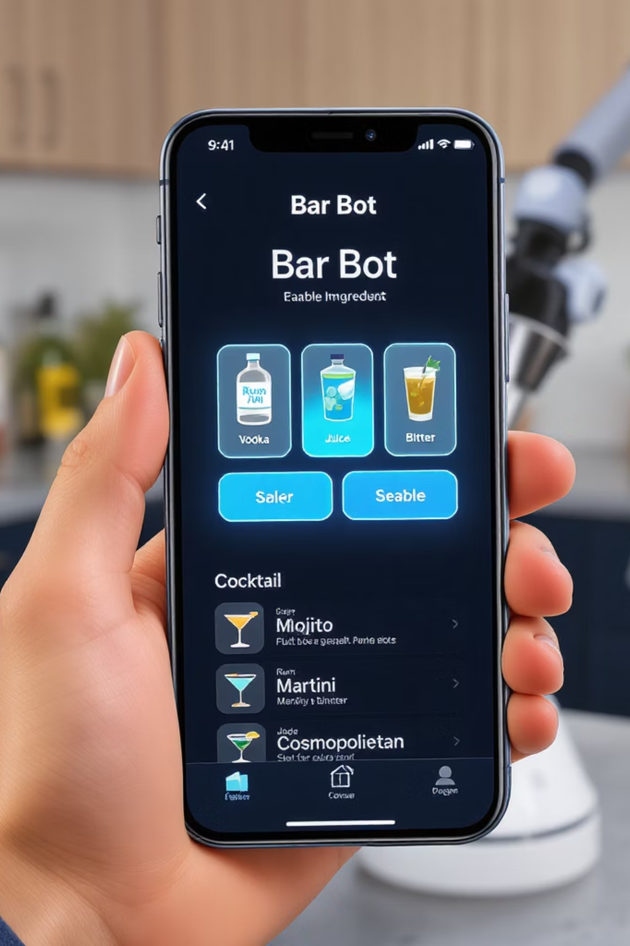

Key Features
Flexible Control
Controlled via serial monitor.
Android app also available.
Customizable Ingredients
Ingredients enabled/disabled easily.
Reassigned with no hassle.
Editable Recipes
Mocktail recipes are customisable.
New recipes easily created.
Simple Integration
Arduino IDE coding supported.
Ingredient swapping is simple.

Slide 4

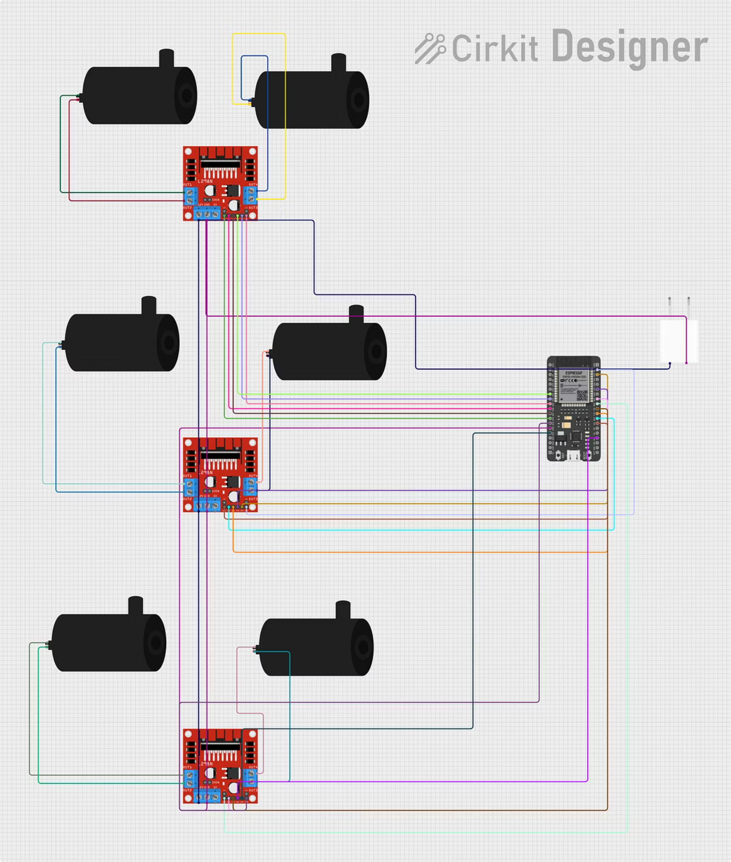
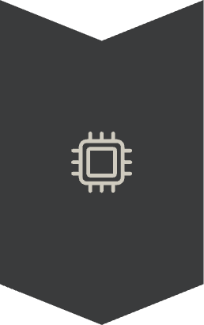
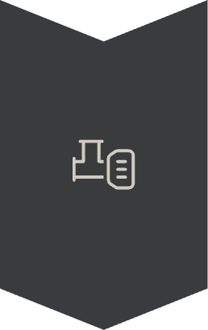


Technical Architecture
ESP32 Microcontroller
Core processing unit.
Powers Bar bot's operations.
Motor Pumps
Connected for liquid dispensing.
Ensures precise pours.
REST API / Web Interface
Enables remote drink orders.
Web page in prototype stage.
Optional RFID
Tracks user drink history.
Currently in development.

Slide 5
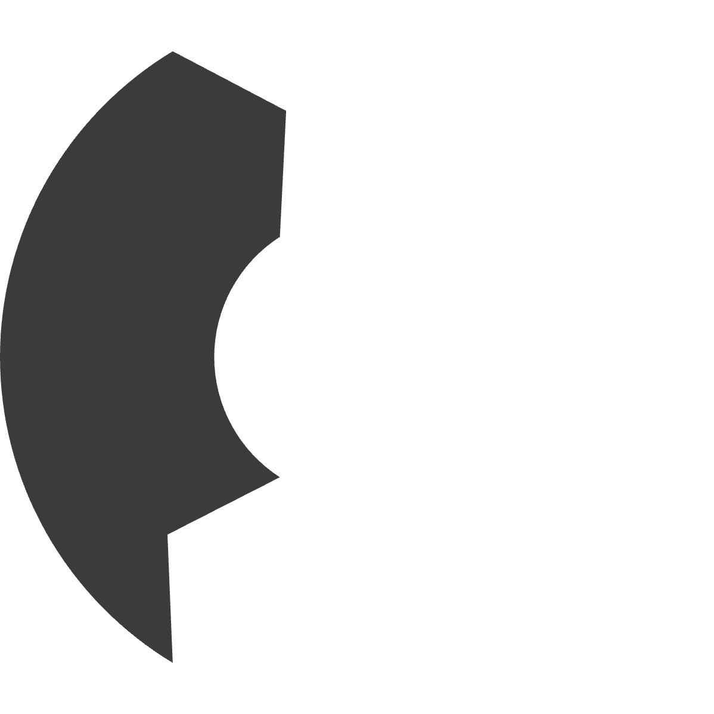





How Users Interact
Customise Quantities
Requires simple change in code
Choose Drinks
Adjust ingredient amounts.
Select from a menu.
Create unique recipes.
Use Serial monitor app or
Serial Monitor on Arduino IDE
Send Orders
Orders sent wirelessly.
Bar bot starts preparation.

Slide 6
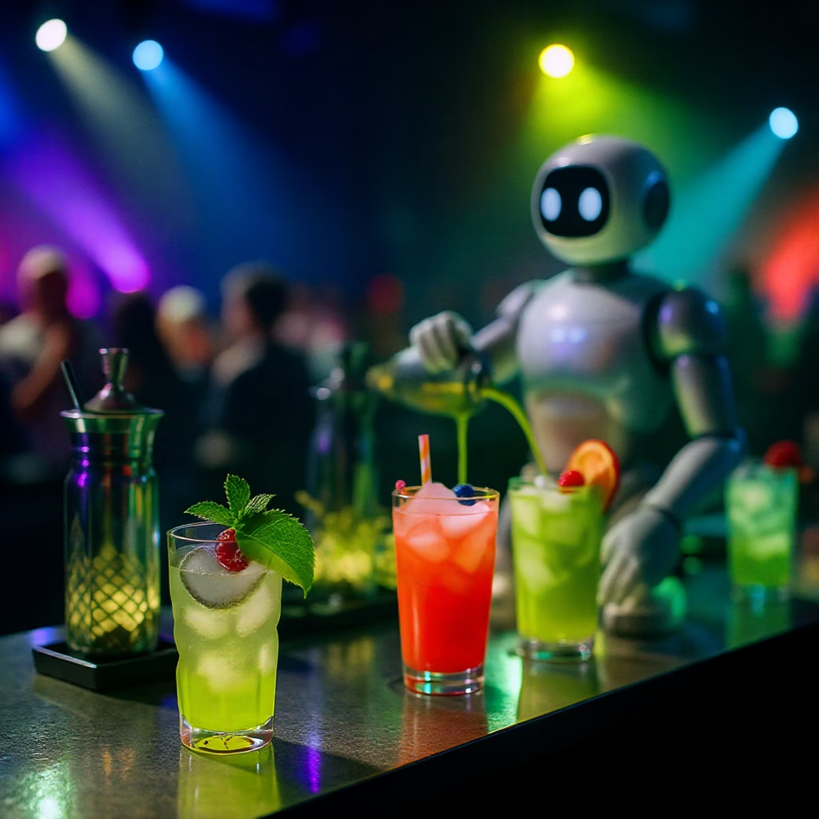
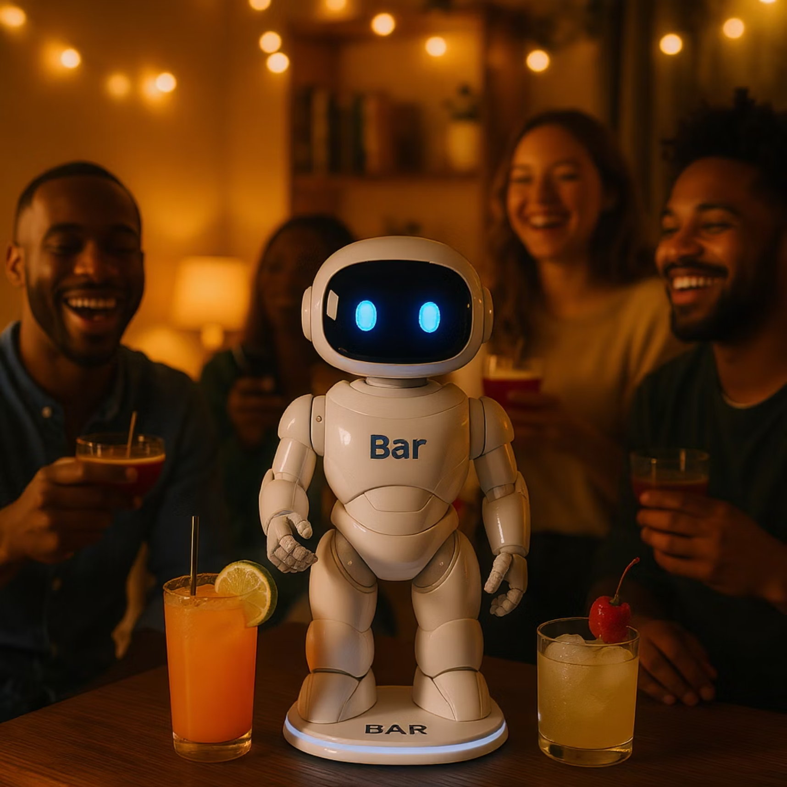
Real-World Use Cases
Event Bars
Home Entertaining
Fast, consistent mocktails.
Adds novelty and convenience.
Serves many guests efficiently.
Impresses party hosts and guests.

Slide 7
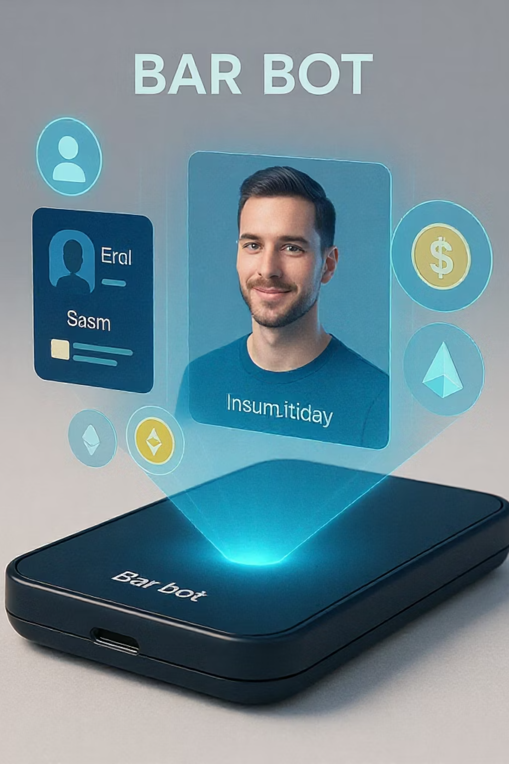
Future Enhancements
User Profiling
Manages drink history.
Offers personalised suggestions.
Facial Recognition
Enables personalised service.
Recognises returning users.
Payment Integration
Supports cryptocurrencies.
Ideal for commercial use.
3D Printed Components
Lowers hardware cost.
Enhances accessibility.

Slide 8
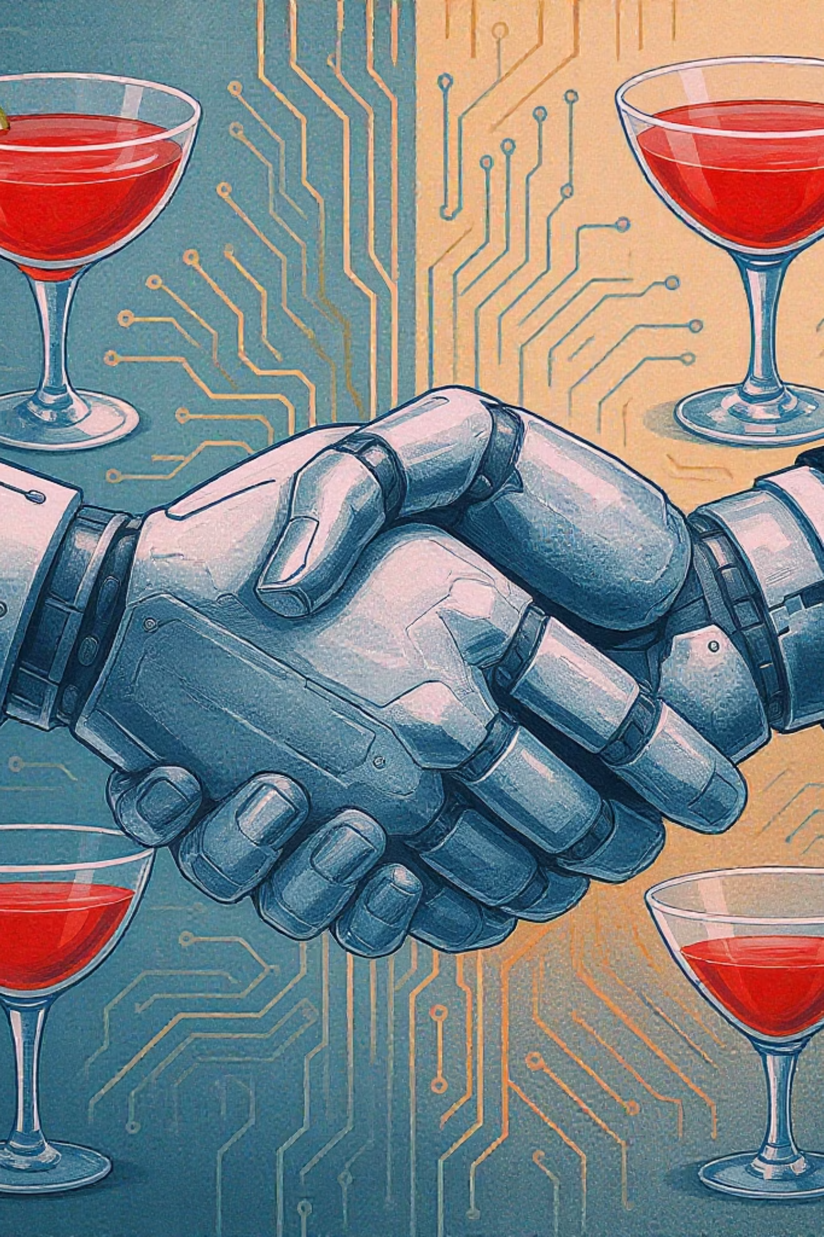

Conclusion
Bar bot seamlessly blends robotics and mixology for efficiency and fun. Its open-source foundation offers endless innovation. There is growing interest from tech and hospitality communities. We are excited about Bar bot's potential.

